Slide 1
Fundamentals of Programming
Number Systems, Base Conversions, and Computer Data

Slide 2
Numbers
Natural numbers
The positive whole numbers. e.g 7, 0, 12
Negative Numbers
Numbers less than 0 e.g -36, -47, -1
Integers
Natural and negative numbers e.g 0, -3, 57
Rational Numbers
Numbers expressed as fraction e.g 2/7, -9/11, 20

Slide 3
Number Systems
A numbering systems assigns meaning to the position of numeric symbols
What is 642?
It depends upon the numbering system
In Base 10, it means 642 = 600 + 40 + 2
Which is in fact
6 x 100 + 4 x 10 + 2 x 1 = 6 x 10² + 4 x 10¹ + 2 x 10⁰ = 642
The base of a number determines the number of digits (e.g. symbols) and the value of digit positions.

Slide 4
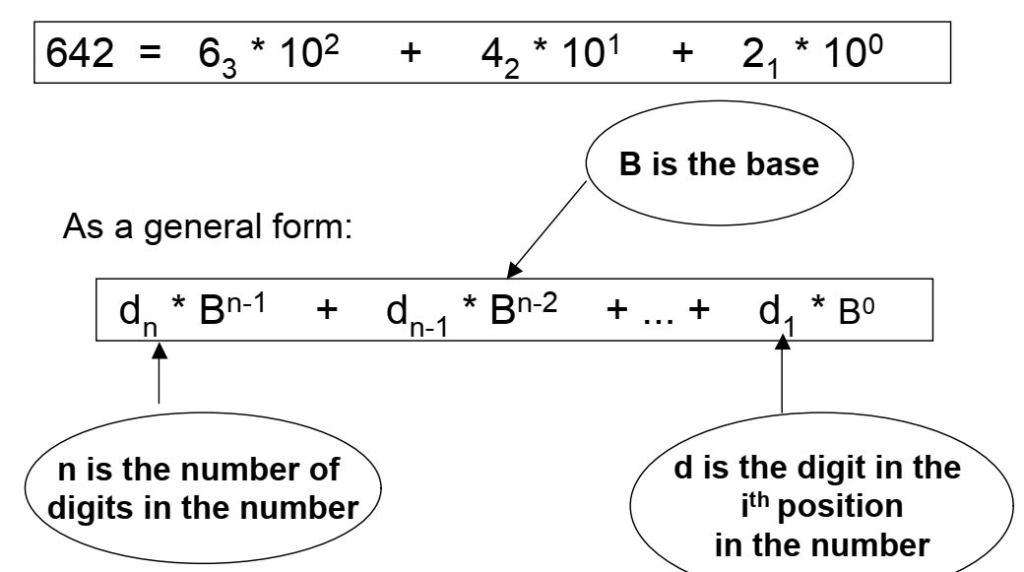
Number Systems

Slide 5
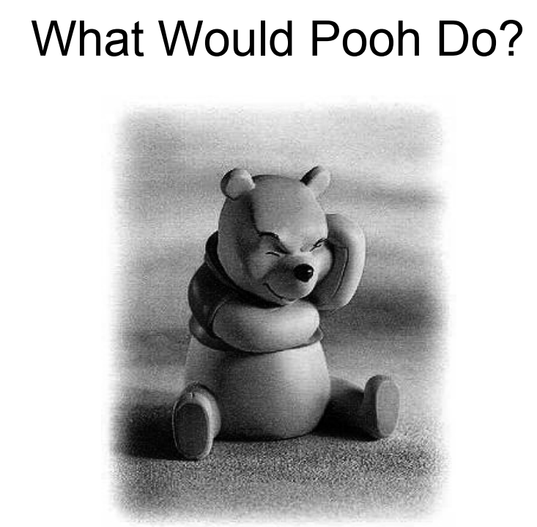
Number Systems

Slide 6
Number Systems
Base 10
Decimal is base 10 and has 10 digits: 0, 1,2, 3, 4, 5, 6, 7, 8, 9
Base 2
Binary is base 2 and has 2 digits, so we use only 2 symbols: 0, 1
0 and 1 in computer is often referred as bit (binary digit)
The bit is the smallest piece of information that can be stored in a computer. It can have one of two values 0 or 1. Think of a bit as a switch that can be either on or off.
From the hardware perspective, ON and OFF can be represented as voltage levels. (typically 0V for logic 0 and +3.3 to +5V for logic 1)
4 bits form a Nibble and 8 bits form a Byte

Slide 7
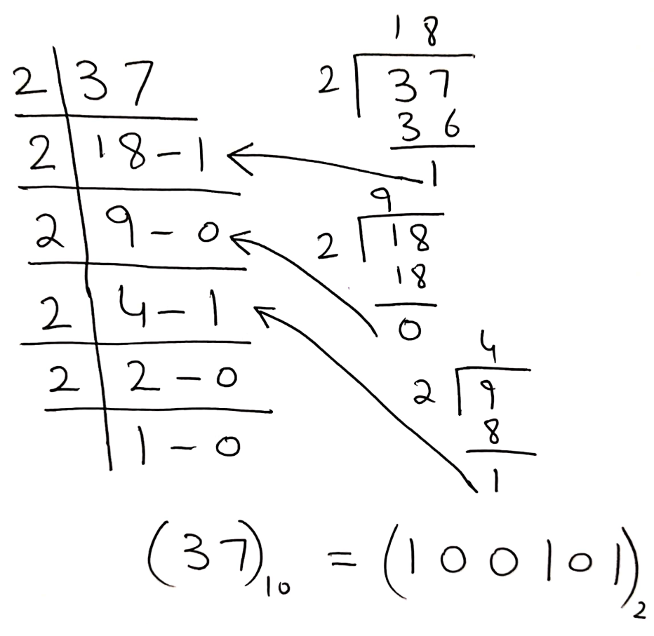
Conversion
From Decimal to Binary
(37)₁₀ = (100101)₂
From Binary to Decimal
(100101)₂ = (37)₁₀
= 1x2⁵ + 0x2⁴ + 0x2³ + 1x2² + 0x2¹ + 1x2⁰
= 32 + 0 + 0 + 4 + 0 + 1
= 37

Slide 8
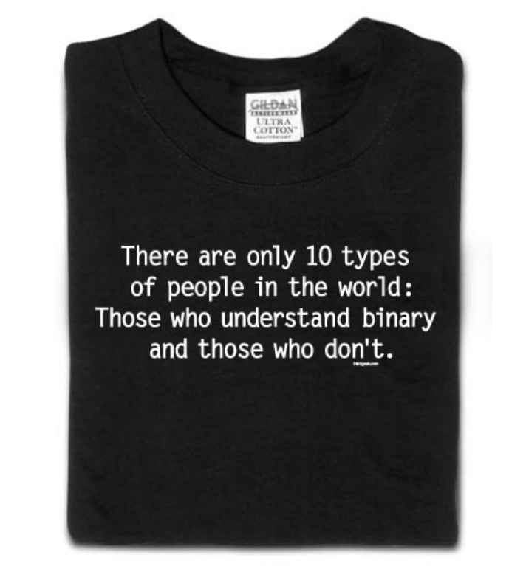
???

Slide 9
Number Systems
Base 10
Decimal is base 10 and has 10 digits: 0, 1,2, 3, 4, 5, 6, 7, 8, 9
Base 2
Binary is base 2 and has 2 digits, so we use only 2 symbols: 0, 1
Base 8
Octal is base 8 and has 8 digits: 0, 1,2, 3, 4, 5, 6, 7
Base 16
Hexadecimal is base 16 and has 16digits: 0, 1,2, 3, 4, 5, 6, 7, 8, 9, A, B, C, D, E, F

Slide 10
Number Systems
Decimal | Binary | Octal | Hex
0 | 0000 | 0 | 0
1 | 0001 | 1 | 1
2 | 0010 | 2 | 2
3 | 0011 | 3 | 3
4 | 0100 | 4 | 4
5 | 0101 | 5 | 5
6 | 0110 | 6 | 6
7 | 0111 | 7 | 7
Decimal | Binary | Octal | Hex
8 | 1000 | 10 | 8
9 | 1001 | 11 | 9
10 | 1010 | 12 | A
11 | 1011 | 13 | B
12 | 1100 | 14 | C
13 | 1101 | 15 | D
14 | 1110 | 16 | E
15 | 1111 | 17 | F

Slide 11
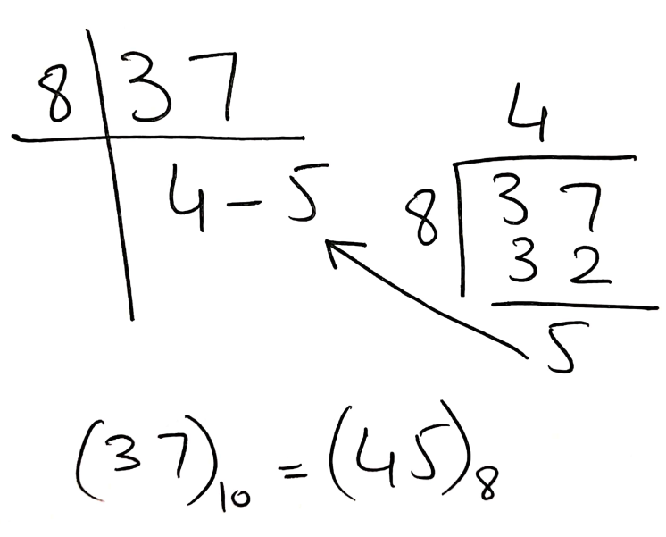
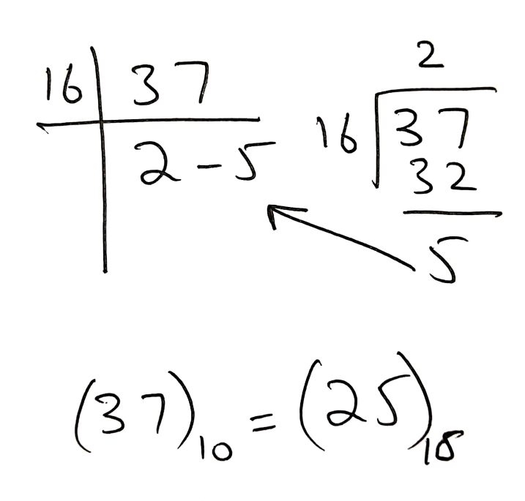
Conversion
From Decimal to Binary
(37)₁₀ = (100101)₂
From Decimal to Octal
(37)₁₀ = (45)₈
From Decimal to Hex
(37)₁₀ = (25)₁₆

Slide 12
Conversion
From Binary to Decimal
(100101)₂ = (37)₁₀
= 1x2⁵ + 0x2⁴ + 0x2³ + 1x2² + 0x2¹ + 1x2⁰
= 32 + 0 + 0 + 4 + 0 + 1
= 37
From Octal to Decimal
(45)₈ = 4x8¹ + 5x8⁰ = 32 + 5 = (37)₁₀
From Hex to Decimal
(25)₁₆ = 2x16¹ + 5x16⁰ = 32 + 5 = (37)₁₀

Slide 13
Conversion
Octal | Hex | Binary
0 | 0 | 0000
1 | 1 | 0001
2 | 2 | 0010
3 | 3 | 0011
4 | 4 | 0100
5 | 5 | 0101
6 | 6 | 0110
7 | 7 | 0111
Octal | Hex | Binary
10 | 8 | 1000
11 | 9 | 1001
12 | A | 1010
13 | B | 1011
14 | C | 1100
15 | D | 1101
16 | E | 1110
17 | F | 1111
Binary to Octal and Hex
(37)₁₀ = (100101)₂ = (45)₈ = (25)₁₆
4 5
100101
2 5

Slide 14
Binary and Computers
Byte
8 bits – a common unit of computer memory.
Word
A computer word is a group of bits which are passed around together during computation.
The word length of the computer’s processor is how many bits are grouped together.
8-bit machine (e.g. Nintendo Gameboy, 1989)
16-bit machine (e.g. Sega Genesis, 1989)
32-bit machines (e.g. Sony PlayStation, 1994)
64-bit machines (e.g. Nintendo 64, 1996)

Slide 15
Use of Hex
Computer works with binary
But its tedious/ hard for us to remember and write those long binary numbers
Solution: Some shorter notation
Hex
0001 0110 1111 1111 1001 0110 0100 0001 1001 = 0x16FF96419
Prefix 0x…

Slide 16
Fixed Precision and Overflow
8 bits hold numbers from 0-255
(255)₁₀ = (11111111)₂
Adding one to 255 will result in 256 which require 9 bits
Thus overflow will occurs:
An overflow occurs when the result of a calculation can’t be represented with the number of bits available
The low order bits of the result will remain valid, but the high order bits will be lost
255
+ 1
-----
256
11111111
+ 1
----------
100000000
255 + 1 = 0

Slide 17
Negative Numbers
How to treat negative numbers?
Negative binary numbers are represented by the ‘-’ sign followed by the magnitude of the number. The computer however does not have a means of representing signs. The sign has to be captured in the bit pattern itself.
Allocate one bit for the sign, 0 for +ve and 1 for -ve

Slide 18
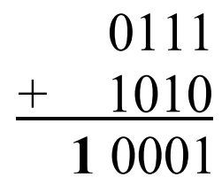
Signed and Unsigned Numbers
Dec | Binary | Dec | Binary
0 | 0000 | 8 | 1000
1 | 0001 | 9 | 1001
2 | 0010 | 10 | 1010
3 | 0011 | 11 | 1011
4 | 0100 | 12 | 1100
5 | 0101 | 13 | 1101
6 | 0110 | 14 | 1110
7 | 0111 | 15 | 1111
Dec | Binary | Dec | Binary
0 | 0000 | -0 | 1000
1 | 0001 | -1 | 1001
2 | 0010 | -2 | 1010
3 | 0011 | -3 | 1011
4 | 0100 | -4 | 1100
5 | 0101 | -5 | 1101
6 | 0110 | -6 | 1110
7 | 0111 | -7 | 1111
Signed Number
7 – 2 = 5
Wrong

Slide 19
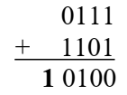
Signed and Unsigned Numbers
Dec | Binary | Dec | Binary
0 | 0000 | 8 | 1000
1 | 0001 | 9 | 1001
2 | 0010 | 10 | 1010
3 | 0011 | 11 | 1011
4 | 0100 | 12 | 1100
5 | 0101 | 13 | 1101
6 | 0110 | 14 | 1110
7 | 0111 | 15 | 1111
Dec | Binary | Dec | Binary
0 | 0000 | -0 | 1111
1 | 0001 | -1 | 1110
2 | 0010 | -2 | 1101
3 | 0011 | -3 | 1100
4 | 0100 | -4 | 1011
5 | 0101 | -5 | 1010
6 | 0110 | -6 | 1001
7 | 0111 | -7 | 1000
1’s Compliment
Invert the bits
7 – 2 = 5
Wrong

Slide 20
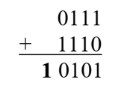
Signed and Unsigned Numbers
Dec | Binary | Dec | Binary
0 | 0000 | 8 | 1000
1 | 0001 | 9 | 1001
2 | 0010 | 10 | 1010
3 | 0011 | 11 | 1011
4 | 0100 | 12 | 1100
5 | 0101 | 13 | 1101
6 | 0110 | 14 | 1110
7 | 0111 | 15 | 1111
Dec | Binary | Dec | Binary
0 | 0000 | -1 | 1111
1 | 0001 | -2 | 1110
2 | 0010 | -3 | 1101
3 | 0011 | -4 | 1100
4 | 0100 | -5 | 1011
5 | 0101 | -6 | 1010
6 | 0110 | -7 | 1001
7 | 0111 | -8 | 1000
2’s Compliment
Invert the bits,
add 1
7 – 2 = 5

Slide 21
Real Numbers
Real numbers have decimal point
2.54, 3.57 etc
Study: How to convert real decimal numbers to binary

Slide 22
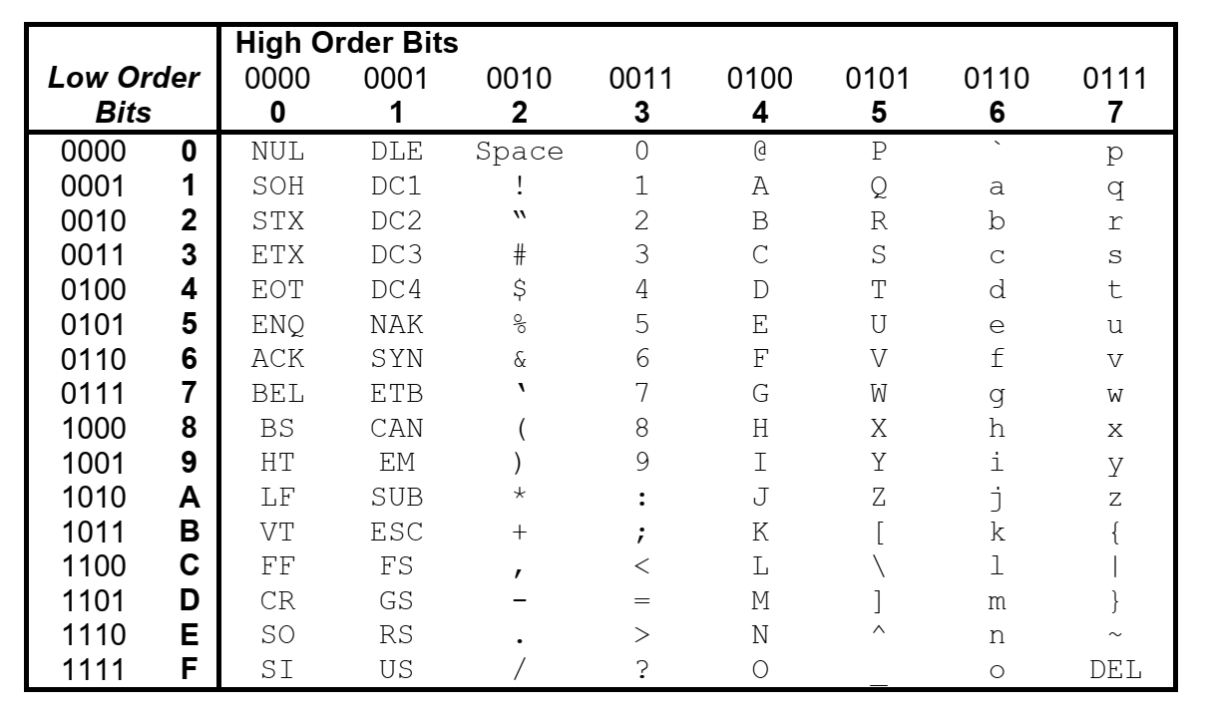
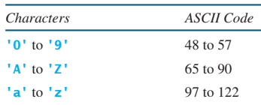
ASCII Encoding

Slide 23
References
Number Systems
Department of Aeronautics and Astronautics, MIT
Number Systems, Base Conversions, and Computer Data Representation
Washington State University
CS101 Lecture 11: Number Systems and Binary Numbers
Aaron Stevens
Number Systems
Ajayi Olusola Olajide
Dont Study
Excess Notation
Bias Notation
Floating Point Notation

